Slide 1
Kp/Ap forecast verification paper

Slide 2
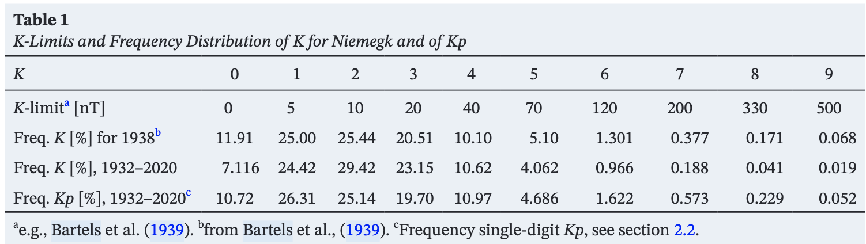
The Kp index
Kp is a geomagnetic index designed to measure subauroral geomagnetic disturbance on a global scale
Kp utilizes quasi-logarithmic scale from 0 to 9 in 27 increments. Given either as 1.00, 1.33, 1.67 … or 1o, 1+, 2-
Each day is divided into 8, 3-hour intervals and one Kp value is given for each interval
Distribution of Kp values
Kp available continuously since 1932

Slide 3
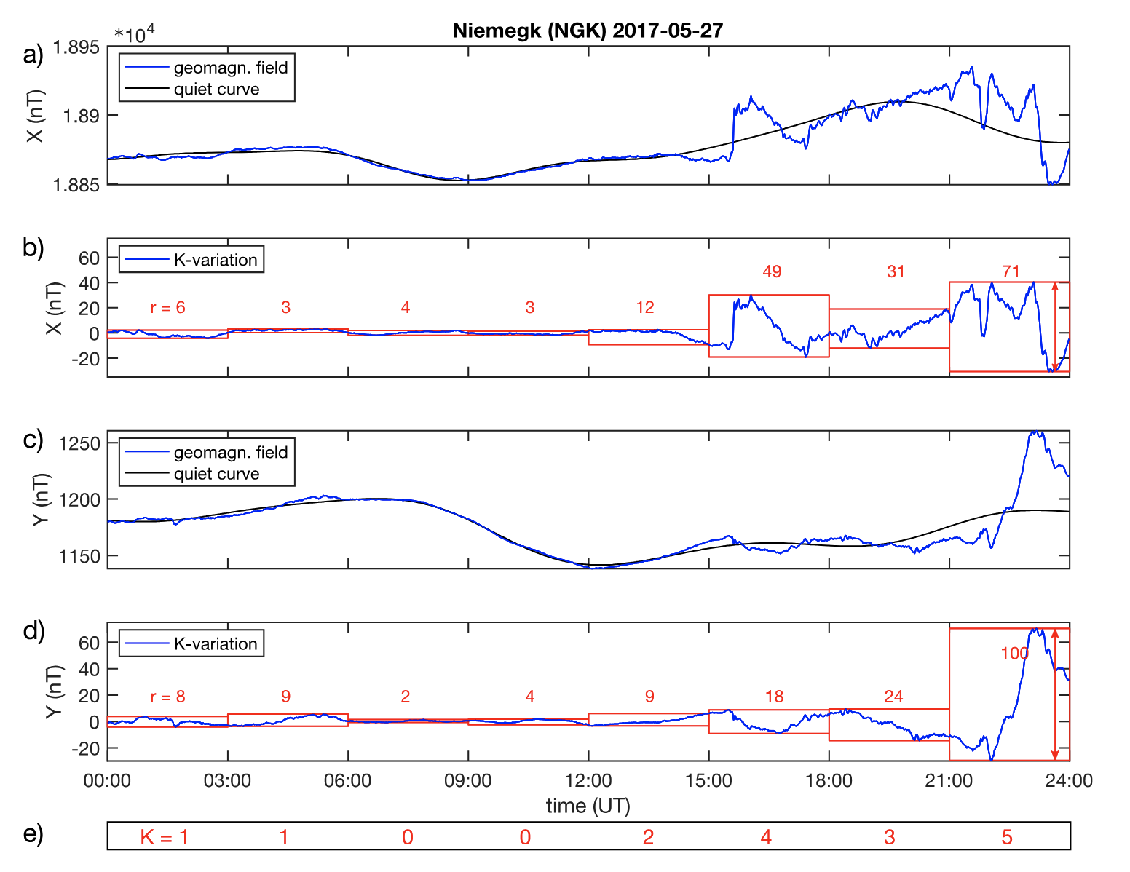
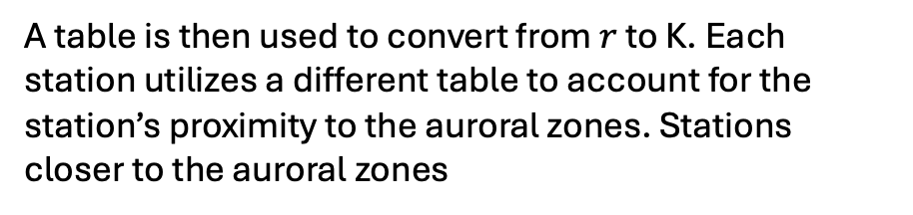
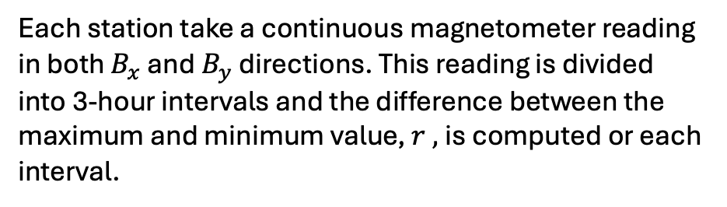
How Kp is Calculated
Each station take a continuous magnetometer reading in both $B_{x}$ and $B_{y}$ directions. This reading is divided into 3-hour intervals and the difference between the maximum and minimum value, $r ,$is computed or each interval.
A table is then used to convert from $r$ to K. Each station utilizes a different table to account for the station’s proximity to the auroral zones. Stations closer to the auroral zones
A weighted average of all stations K values is used to compute the planetary K index, Kp
J. Matzka et. al 2021

Slide 4
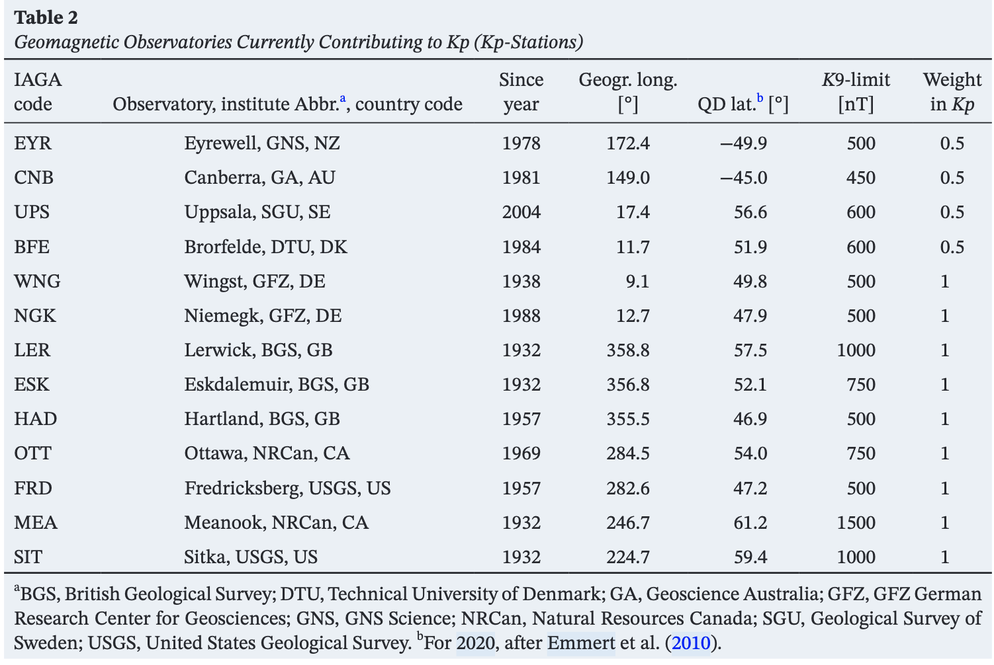
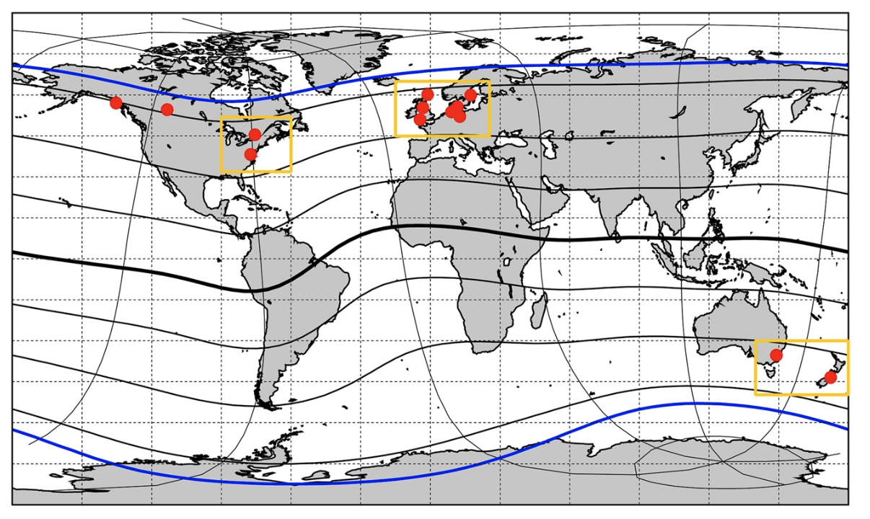
Kp Stations
13 magnetometer stations at subauroral latitudes
Four stations are weighted at 0.5
J. Matzka et. al 2021

Slide 5
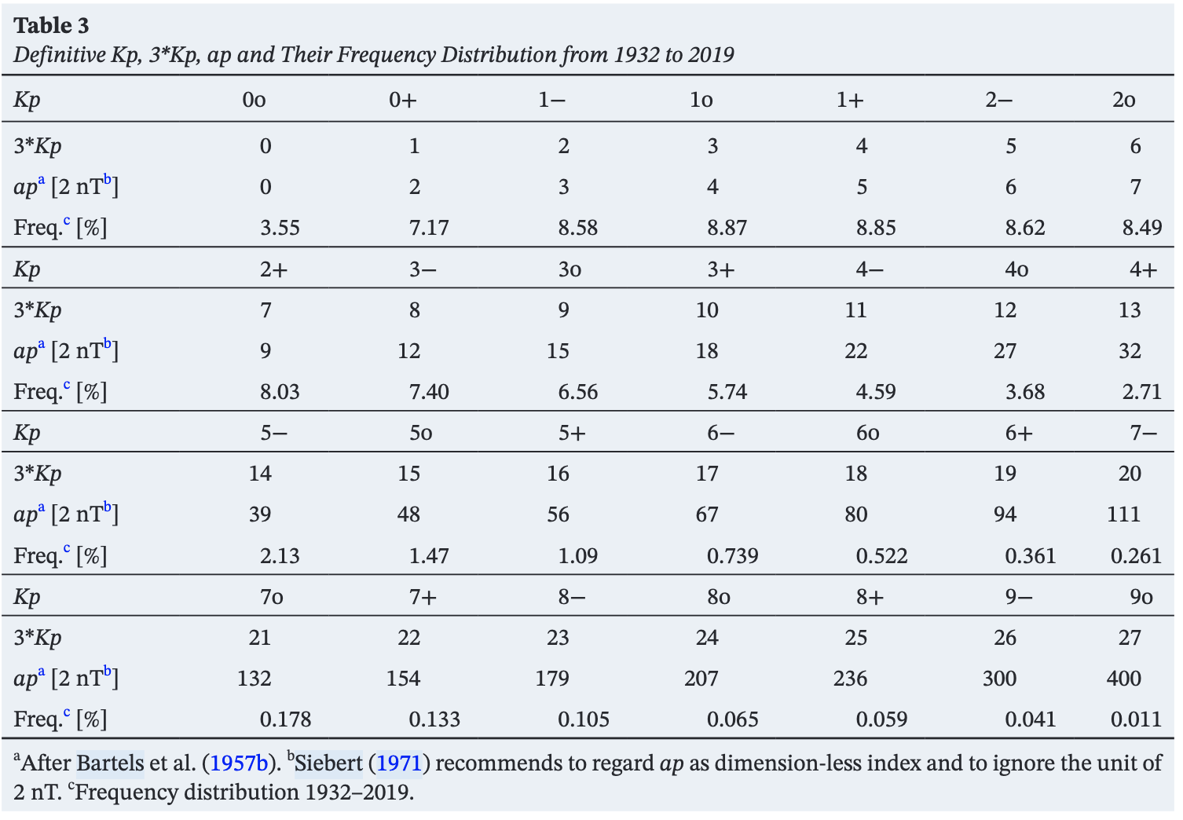
Kp vs. ap vs. Ap
ap is a linearized Kp on a 0 to 400 scale. Most often regarded as unitless but can be interpreted to have unit of 2 nT
Ap is the mean of each days 8 ap values
J. Matzka et. al 2021

Slide 6
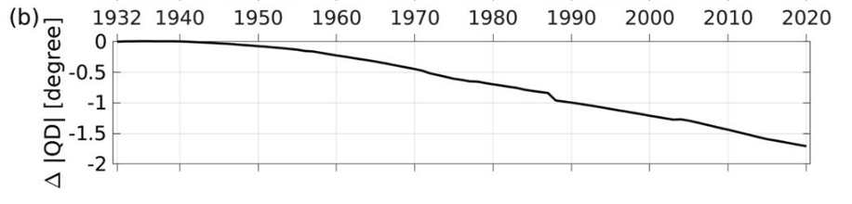
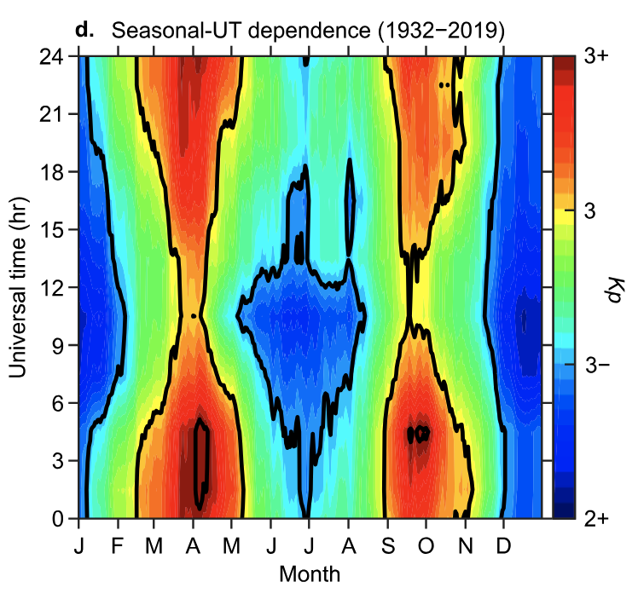
Variation of Kp
Due to long term variation of earths geomagnetic field, the auroral zones have shifted slightly away from the magnetometer stations causing a negative Kp bias of approximately 1/3 of a unit
During the equatorial maximums (April and October) the earths geomagnetic field has a stronger alignment with the incoming geomagnetic storms, leading to a seasonal variation of up to 1 unit
My own plot showing average Kp for each month
J. Matzka et. al 2021

Slide 7
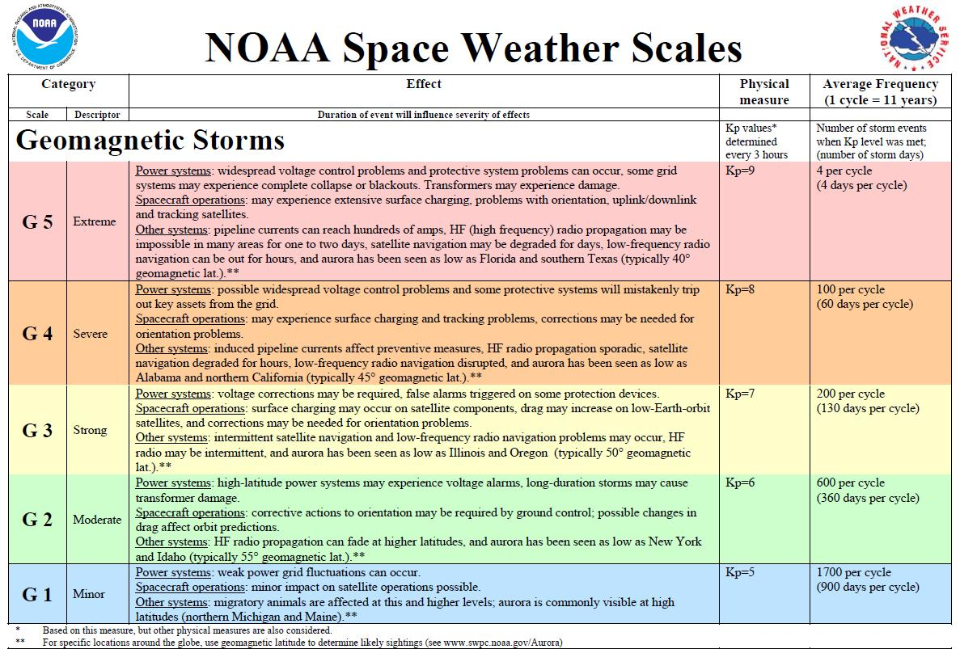
Utility of Kp
Used by SWPC for determining/forecasting geomagnetic storm intensity
Used by SWPC for issuing geomagnetic storm advisories and warning s
Used as a forcing to drive large geophysical models such as WAM-IPE and WACCM-X

Slide 8

Data Source for Kp
Definitive Kp is provided by the Helmholtz Centre for Geoscience (GFZ) on a semimonthly basis
Nowcast Kp is also provided by GFZ. Nowcast Kp can change for a few days after the measurement date
Nowcast Kp is almost always correct within 1/3 of a unit

Slide 9
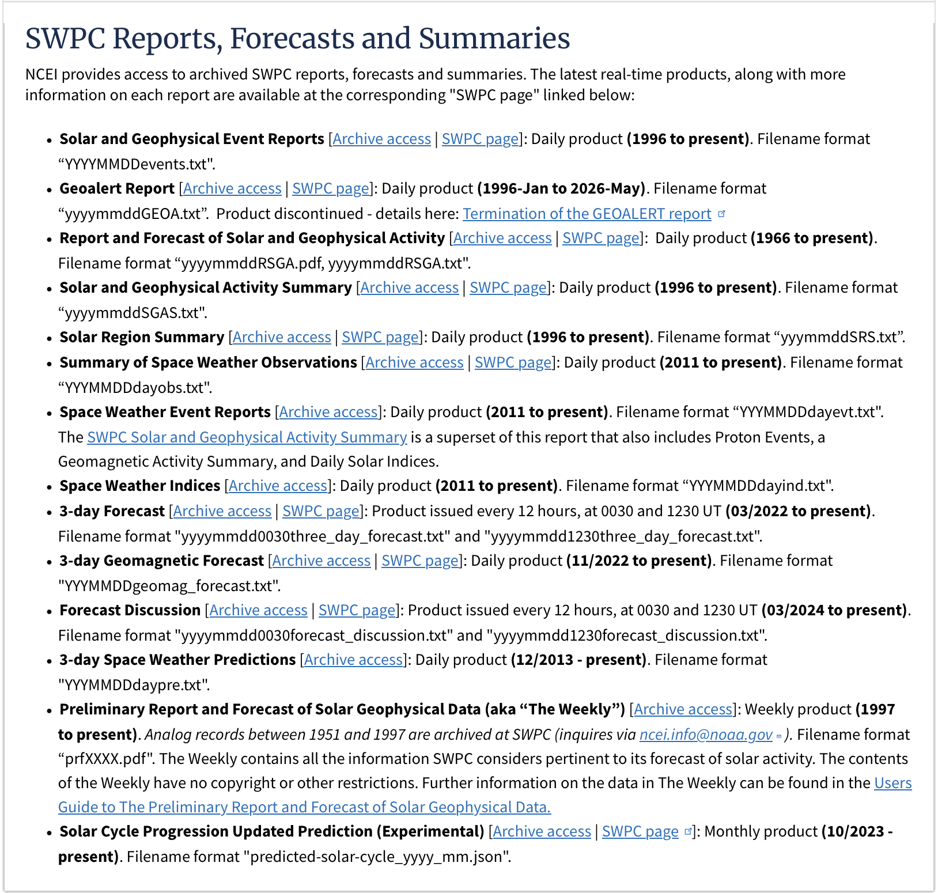
SWPC Forecast overview
NOAA’s Space Weather Prediction Center is responsible for releasing national forecasts and alerts for geomagnetic storms
SWPC releases a variety of reports containing information and forecasts ranging from solar active regions, solar flares, and geomagnetic storms
SWPC releases a 72-hour Kp forecast in the “3-day Geomagnetic Forecast” (Nov 2022-Present) and the ”3-day Forecast” (Mar 2022-Present) products
We also utilize some historical SWPC data which Andong got from somewhere containing a 7-day Kp forecast (2011-2025)
All active SWPC products. https://www.ncei.noaa.gov/products/space-weather/partners/swpc-products-and-data

Slide 10
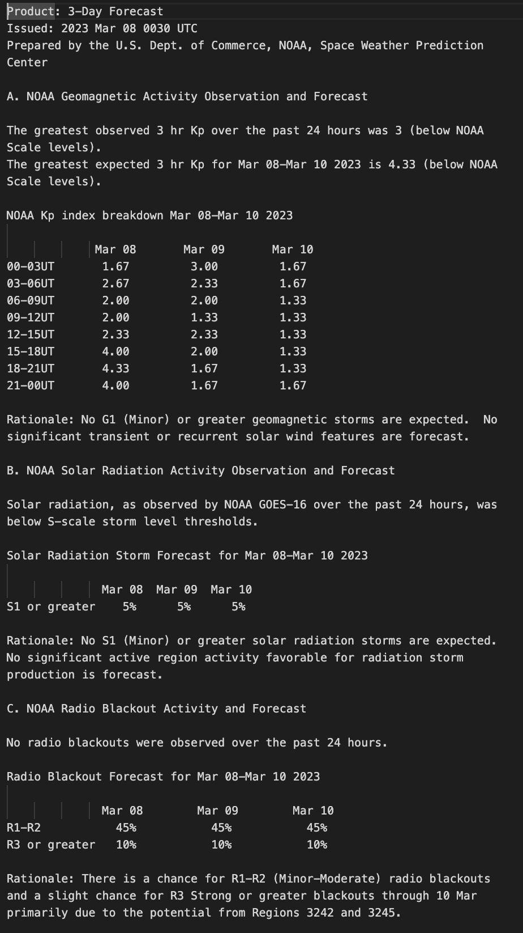
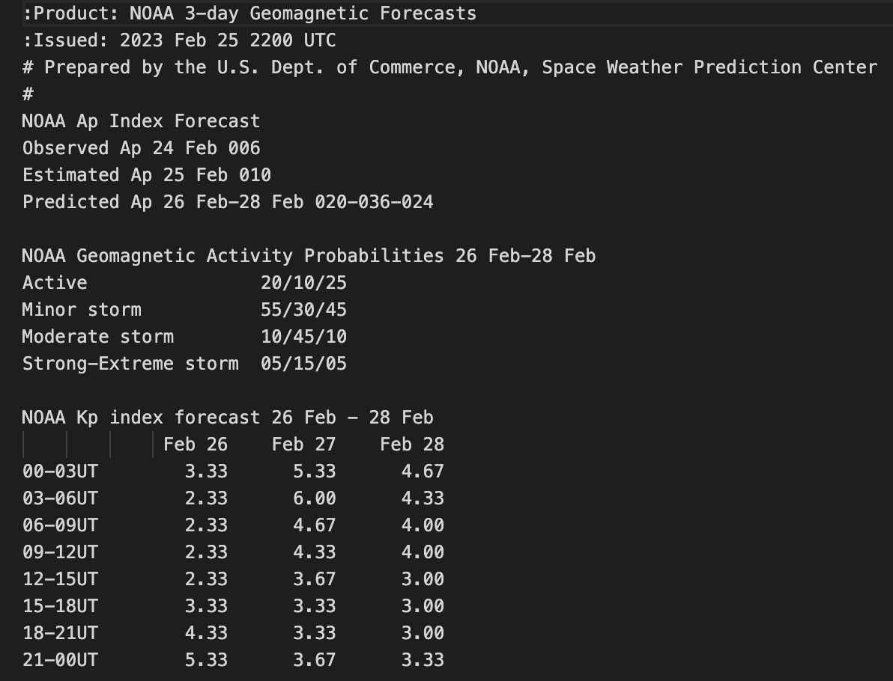
NOAA 3-day Forecast
NOAA 3-day Geomagnetic Forecast
Use some code (Claude) to extract relevant data from text files

Slide 11
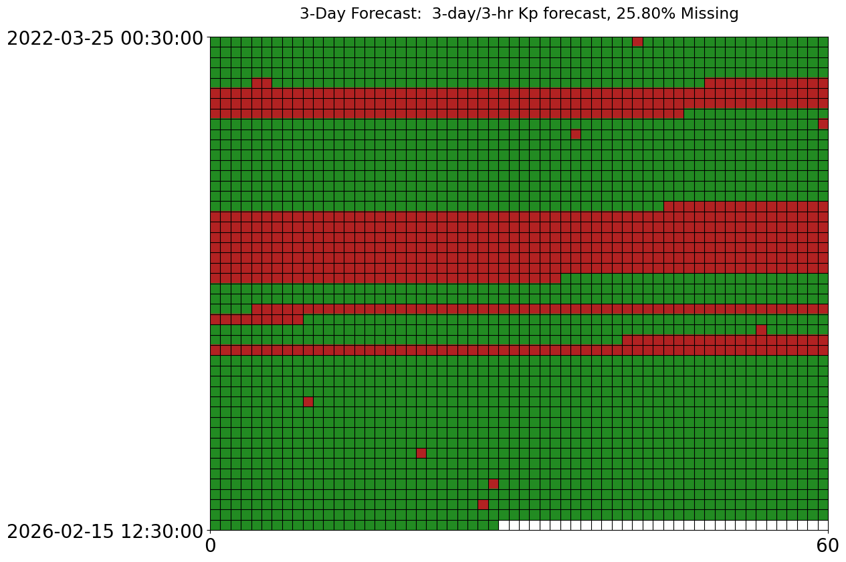
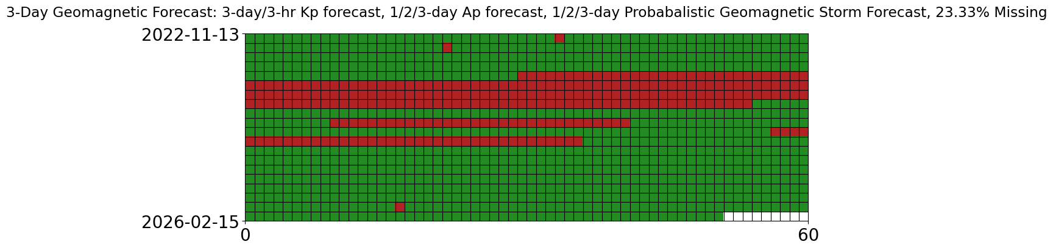
Forecast Availability
3-Day Forecast is released twice per day at 0030UTC and 1230UTC
3-Day Geomagnetic Forecast released daily at 2205UTC
Significant downtime (~25% of total)

Slide 12
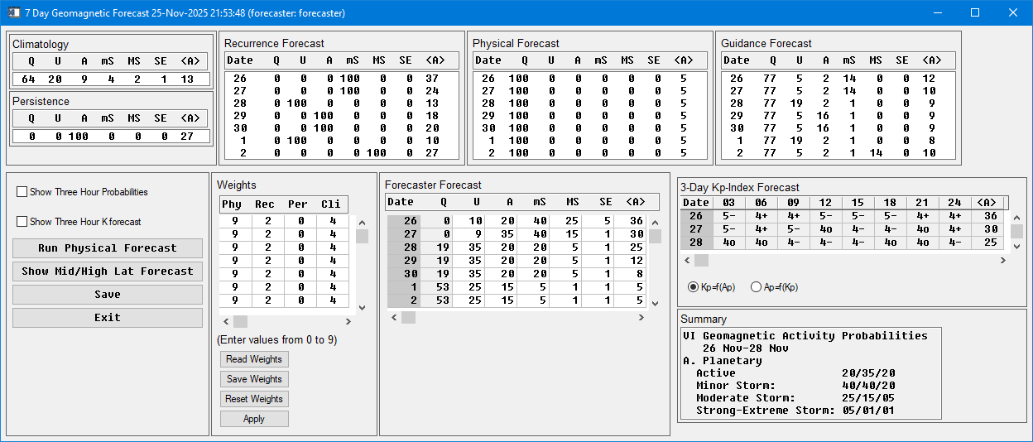
How they make the forecast
Utilize human forecasters interpreting climatology, persistence, recurrence, and potentially some kind of physical forecast
Internal SWPC Forecasting Dashboard

Slide 13
Baseline Forecasts
Persistence
27-day Recurrence
Climatology

Slide 14
Analysis
Do everything in ap?
Overall RMSE
Classification of G1+ and G2+
Storm time
Storm onset
Storm recovery?

